Slide 1
ARL FINal Project Review
Amanda Keebler & Andrew Periard
Group F15C8

Slide 2
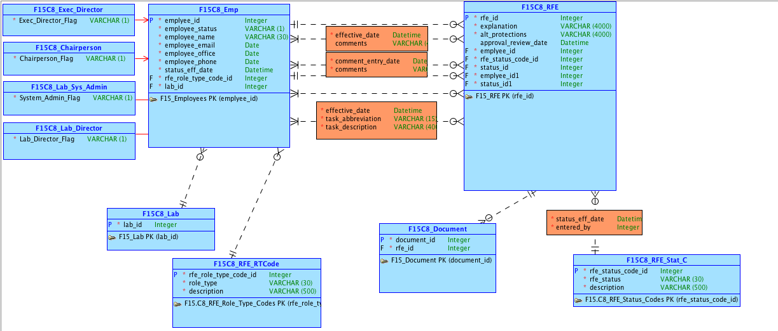
Conceptual Model: Part i

Slide 3
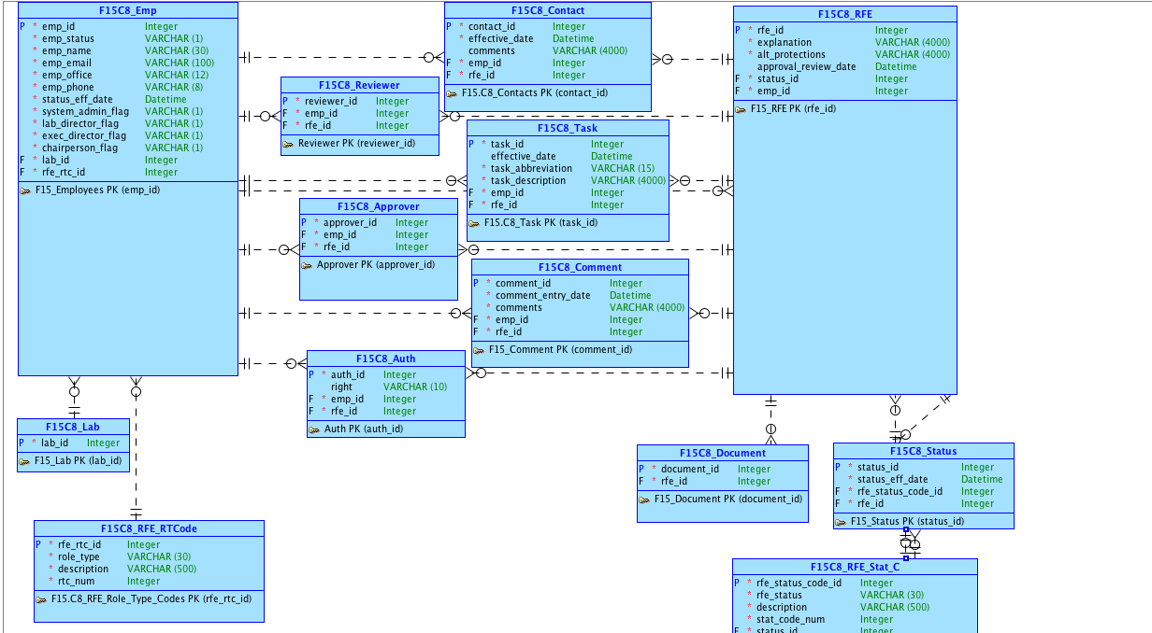
Logical Model: part i

Slide 4
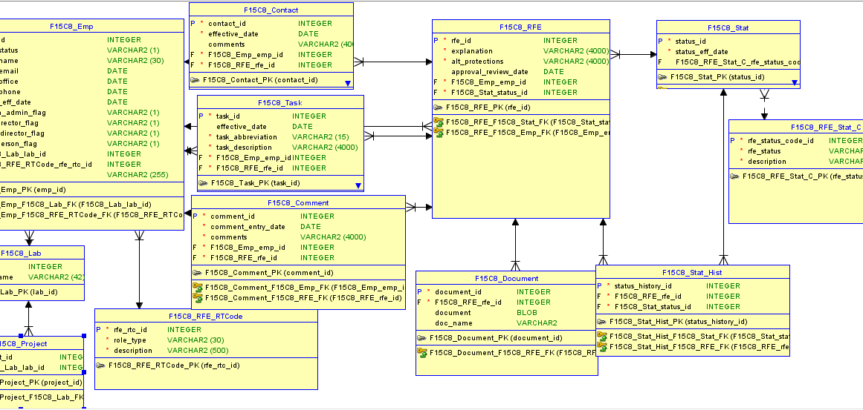
Relational model: part i

Slide 5
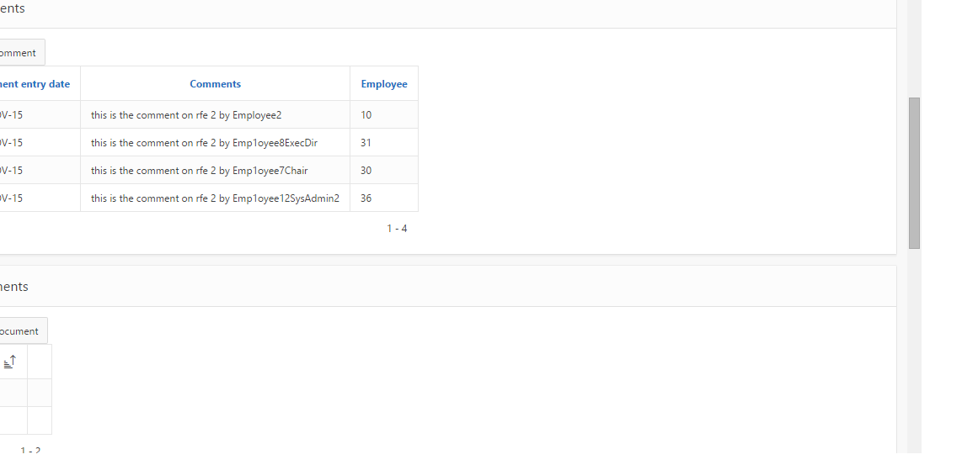
ARL APP

Slide 6
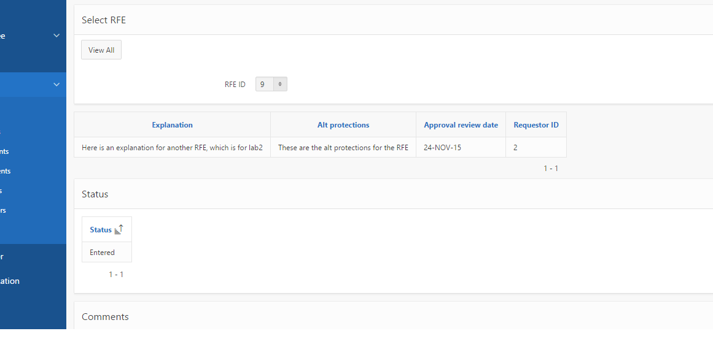
ARL APP

Slide 7
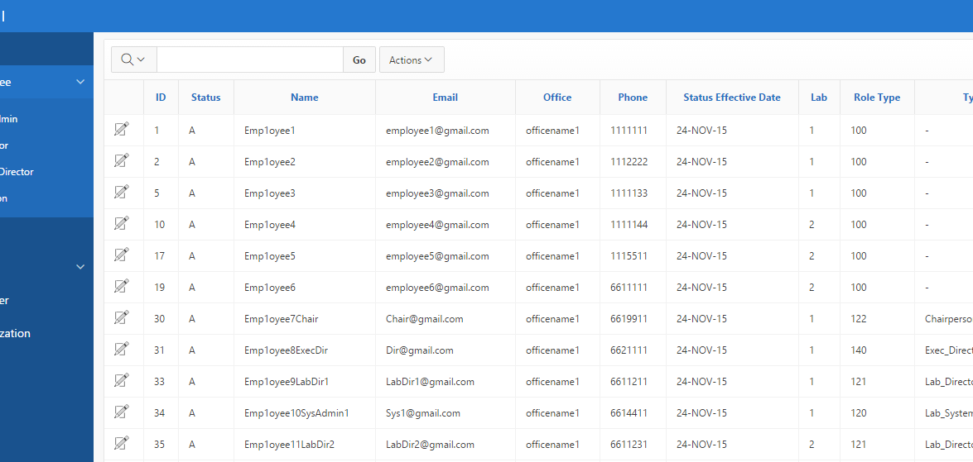
Arl app
https://apex.oracle.com/pls/apex/f?p=98836:3:15336914822282::NO:

Slide 8
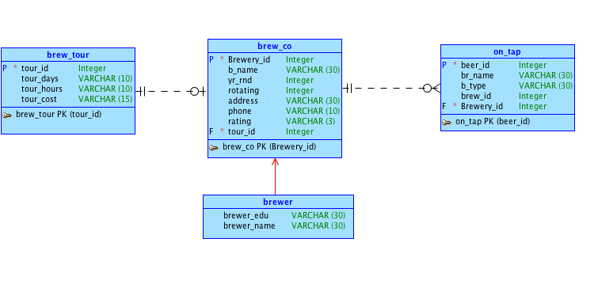
Conceptual model: part ii

Slide 9
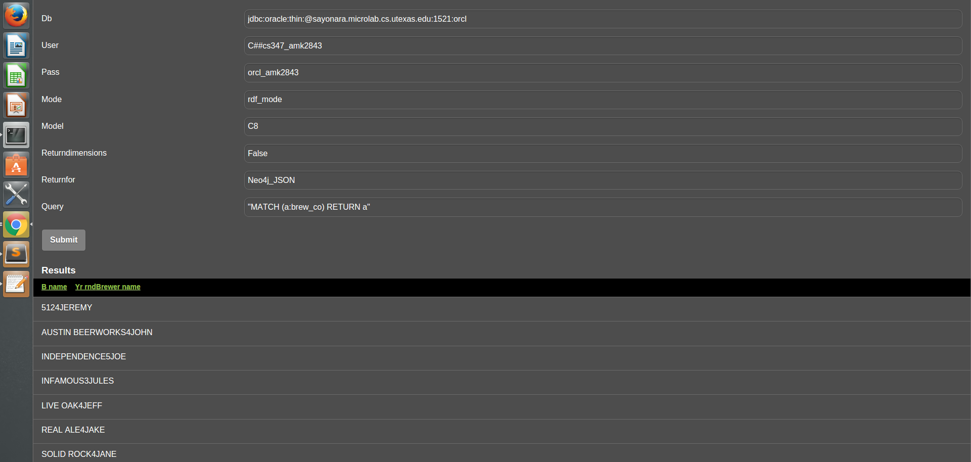
Picture of our mobile app

Slide 10
A little about our mobile app…
A brewApp about the various breweries in the greater Austin area:
What can you do with our app?
-Search for addresses, phone numbers and ratings of the local breweries listed in the DB
-Read a list of the beers each brewery has on tap year around and know how many rotating taps they have for seasonal beers
-Know the names of the brewers at each location and where they got their “brew”-ducation
What else would be great?
-Adding brewery tour information such as cost, days and times

Slide 11
Pointer to git repo & mobile app
Mobile app: https://apex.oracle.com/pls/apex/f?p=100112:2:105435296865591:::
Github Repo: https://.github.com/AndrewPeriard/F15C8

